Slide 1
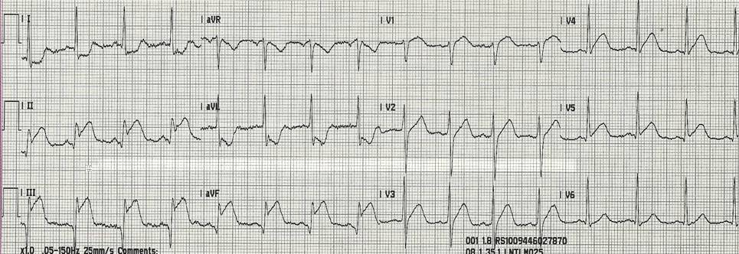
Figure 1. 12-lead ECG during chest discomfort with ST-segment elevation in leads II, III, aVF and ST-segment depression in leads I, aVL

