Slide 1
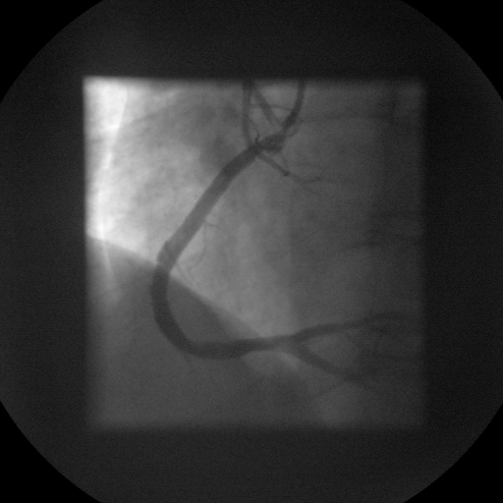
Figure 2. Coronary angiogram shows complete occlusion of the proximal right coronary artery , fully recanalized after thrombus aspiration and stents implantation

