Slide 1
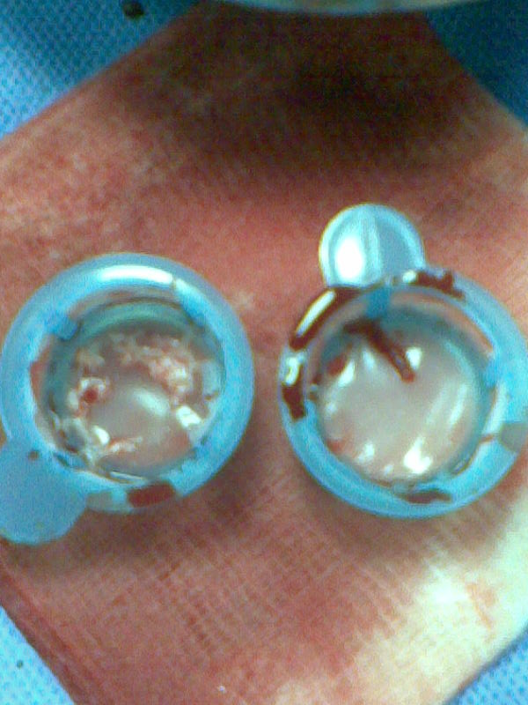
Figure 3. Thrombotic material aspired from the occluded RCA with the use of Export catheter

