Slide 1
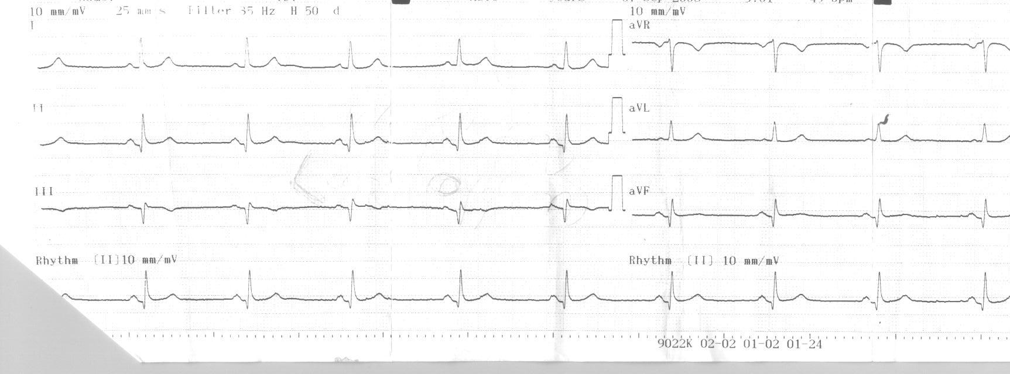
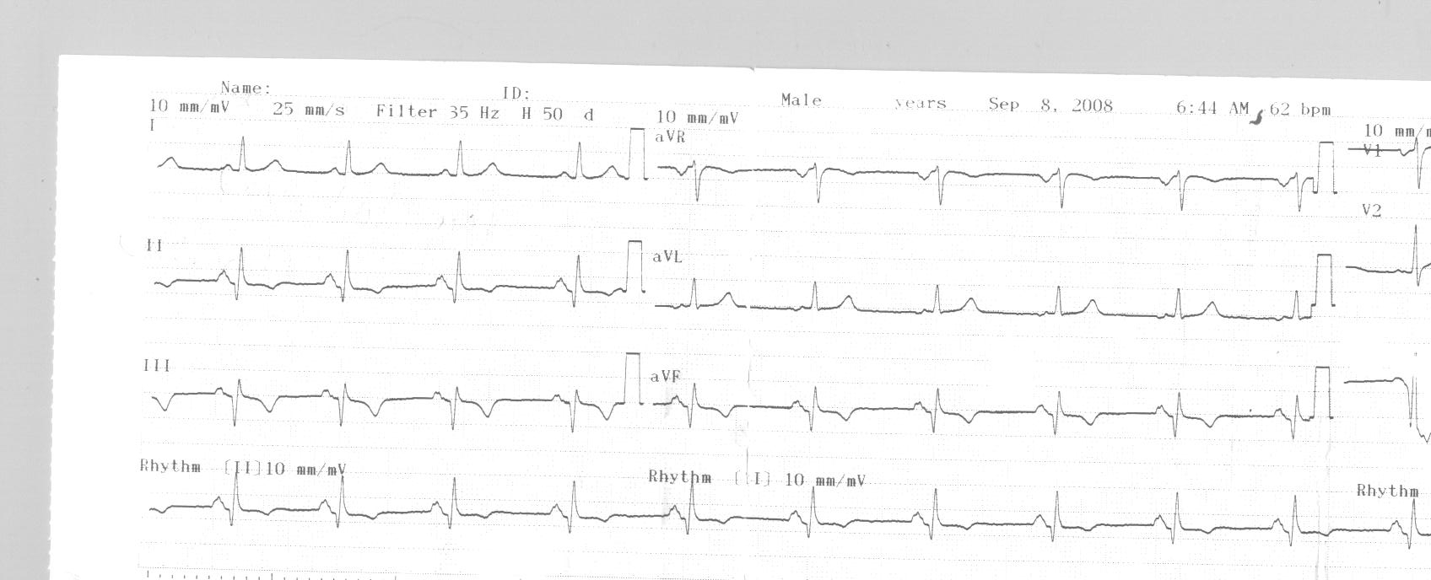
Figure 4. Ischemia of the inferior wall according to ECG findings during the first hours of patient’s monitoring

